Slide 1
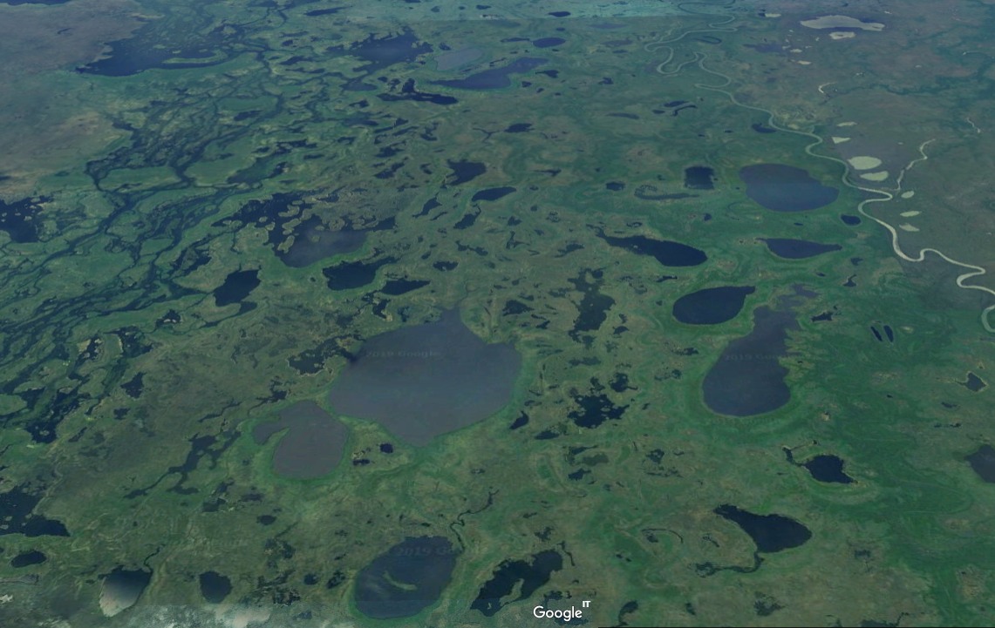
Pantanal Case study

Slide 2
Session objectives
2
1. Good governance
2. Appropriate scale
After this session you will be able to:
Recognize how Brazil has adopted EAFm principles and moved towards EAFm (case study)
Determine where your country is at in moving towards EAFm
Identify challenges your country faces in moving towards EAFm
3. Increased participation
4. Multiple objectives
5. Cooperation & coordination
6. Adaptive management
7. Precautionary approach
2
Notes:
The session has 3 objectives;
The USA experience used here for 1st objective and to guide the 2nd and 3rd objectives.
Objectives 2&3 are addressed through activities

Slide 3
Overview – Brazilian Pantanal case study
This presentation describes the fisheries and the outcome of management policies in the Brazilian part of the Pantanal
National policies have converted fisheries of the Pantanal from a ‘food fishery’ to a recreational fishery, with impacts on the riparian population.
At the same time external pressures are affecting the system.
The session will discuss how:
The approach to fisheries management
How environmental laws and policies have affected the sustainability of the fisheries

Slide 4
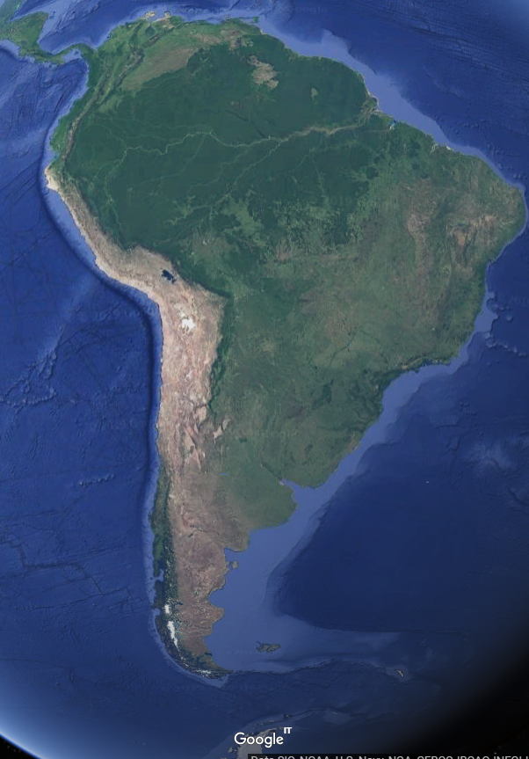
Introduction to the Pantanal
The Pantanal, is a lowland depression in the Upper Paraguay river basin.
world’s largest continuous wetland
Covers ~ 140 000 km² (3% of the world’s wetlands)
Situated mainly in two Brazilian states Mato Grosso and Mato Grosso do Sul
smaller pockets in neighbouring Plurinational State of Bolivia (10-15%) and Paraguay (5-10%)
Mato Grosso
Mato Grosso do Sul
Source: Google Earth

Slide 5
Ecological: Ecosystem
The Pantanal is a huge network of grasslands, scrubs, forests, marshes, lagoons, rivers, lakes and marshes
One of the most biologically diverse systems in the World
Seasonal shift between a predominantly terrestrial to a mostly aquatic ecosystem
Fauna and flora adapted to this dynamic ecology
Fish spawn at the onset of the flood and colonize flooded areas for feeding and growth
When the water withdraws, the fish seek refuge in permanent waterbodies in mass migrations (a phenomenon known as lufada)

Slide 6
Ecological (cont.): Agriculture
Colonized by indigenous hunter-gatherers 3000 BC
Main economic activities: cattle ranching, farming of rice, soy bean, corn, and sugar cane, artisanal fishing, and tourism (principally sportfishing).
The wet-dry regime and the infertile land unsuitable for intensive agriculture, and the region remains thinly populated
Surrounding plains are among the most intensively farmed areas in Brazil
Subject to high and increasing stress from pesticide use, damming of tributaries, deforestation, and mining of gold, diamonds, iron, and manganese
Deforestation on the plateaus, where the rivers feeding the Pantanal originate, cause erosion, high sediment loads and unstable river channels

Slide 7
Ecological (cont.): Threats to the Pantanal
There are around 40 dams (mainly for hydropower) in the region and an additional 101 are planned for construction in the headwaters.
Exotic fish species
transferred from the Amazon Basin,
escapees have established populations in the wild.
Several exotics hybridize with native species.
Possible future threat to the Pantanal ecosystem is the Paraguay-Paraná Waterway Project (Hidrovía)
Plan to interconnect Argentina, Bolivia, Brazil, Paraguay and Uruguay by converting the Paraguay and Paraná rivers into navigable canals
Climate change is predicted to affect the alternating flood and drought cycle over the next decades affecting the Pantanal’s delicate ecosystem.

Slide 8
Fisheries: Small-scale fisheries
Mato Grosso do Sul
1980s: Annual catch: 2 206 tonnes; CPUE ~ 121 kg/fisher/day
1994-1999: CPUE 11.5 kg/fisher/day
By 2016: Annual catch only 187 tonnes
Illegal fishing (perhaps 50% of registered commercial catches)
subsistence fishing (focussing on non-commercial species).

Slide 9
Fisheries: Recreational fisheries
In 1980’s: 17 000 Recreational fishers per year
Since the 1990’s: Recreational fishers have landed at least half of the fish in most years, and in some years up to 80% of the catch.
the total value of the recreational fisheries was between USD 35 and 56 million.
1999, Mato Grosso do Sul received 59 000 tourist fishers.
After the peak, the number of recreational fishers sharply declined and dropped to just 15 000 by 2006

Slide 10
Fisheries: Recreational fisheries (cont.)
Decline in number of recreational fishers appears more related to restrictions put on them (ie. catch quotas, compulsory release of fish) than competition with artisanal sector
2000 quota for recreational fisheries reduced from 25 kg/trip to 15 kg/trip
2003 further reduced to 10 kg plus one fish of any size and five piranhas.
2006 only capture of one scaled and one scale-less fish allowed
For 2019, quota is 5 kg plus one fish of any size, and up to five piranhas.
Every time the government has tightened the restrictions on the recreational fisheries fewer people have arrived in the Pantanal.

Slide 11
Fisheries: SSF vs recreational landings
Subsistence fishers tend to capture mostly species that are of little interest to recreational and commercial fishers such as piranhas
Data from SCPESCA/MS

Slide 12
Fisheries: State of fish stocks
Available studies indicate that Pacu (Piaractus mesopotamicus) is overfished since 1994, both abundance and size of the fish have decreased.
The exploitation of the catfishes cachara (Pseudoplatystoma reticulatum) and barbado (Pinirampus pirinampu) are near the maximum sustainable level.
Other species are not overfished.
Mateus, Vaz and Catella 2011.

Slide 13
Fisheries: Catches in the Pantanal
Catches by recreational and artisanal fishers in Mato Grosso do Sul (1979 - 2016)
Catches were higher in 1980s and declined by 2000
This is due to restrictions on fishing, to overfishing of the stock.
Data from SCPESCA/MS and Mateus, Vaz and Catella 2011.

Slide 14
Economic contribution: environmental services
Ecosystem services provided by the Pantanal
valued at 8 133 – 17 490 USD/ha/year (Moraes 2008)
Environmental services include:
Reduce and delay the flood, and risk of flooding property downstream
Remove sediment and pollutants including heavy metals
Ensure water supply by recharging aquifers
Fishing
Carbon sink
Tourism - 150 000 tourists ~ USD 150 million
Sport fishing is the main tourist attraction valued USD 35 - 56 million per year.

Slide 15
Economic contribution: Income from fisheries related activities in the Pantanal
Type of activity | Necessary investment | Net earnings (USD/month)
 |  | Low season | High season
Bait gathering | Low | 86 | 292
Bait middleman | Middle | 106 | 862
Artisanal fisherman | Low | 90 | 297
Fisherman owning a boat | High | 153 | 1 323
From Chiaravallotti 2019

Slide 16
Governance: Fisheries management
For management purposes fishers are divided in 3 groups:
subsistence fishers,
artisanal or professional fishers and
recreational or sportfishers.
The second and third group of fishers are regulated,
only the second group is allowed to sell their catches
the other two may land fish for own consumption only

Slide 17
Governance: Fisheries management (cont.)
Management regulations include:
minimum size for the most important commercial species
control of fishing effort through fish landing (recreational and commercial fisheries), and transportation quotas
a closed season during the reproductive period of commercially important fish species between November and February
establishment protected areas where only catch-and-release is allowed

Slide 18
Governance: Fisheries management (cont.)
In Mato Grosso do Sul, three different laws were passed between 1983 and 1994 forbidding the use of all fishing nets
When the regulations on fishing gear was first introduced the fishers ignored it due to the economic impact it had on them, but enforcement was strengthened
Initially cast nets were allowed, but only for Prochilodus lineatus,
Since 1993, cast nets banned even for this species eliminating any commercial exploitation of this species - previously one of the most important in the commercial fisheries.

Slide 19
Governance: Traditional Fishing gears
Range of traditional gears use in small-scale fishery
Fixed buoy, buoy, cast nets, set hooks, drift nets/gillnet, bow and arrow, fish light attractor
All are now illegal or their use severely restricted
This has restricted the targeting of some commercially important species
Enforcement has been strengthened
Today, commercial fishermen in the Pantanal can legally only use hook and line
There is a catch quota of 400 kg of fish per month
Mateus, Vaz and Catella 2011.

Slide 20
Governance: Impact on employment
The regulations forced professional fishermen forced to seek alternatives
as guides, and boat drivers
capturing and selling live bait to the recreational fishers
Bait fishers extract 16 million fish and crabs for sale to recreational fishers
In the region of Corumbá estimated that 165 fishermen generate a gross revenue of almost USD 3 million per year
More recently some fish farmers also specialise in producing baitfish
Barletta et al. 2016.

Slide 21
Governance: Commercial and recreational fisher numbers
Declining number of fishers due to restrictions
1994: 4 073 commercial fishers
2016: 3 826 commercial fishers
1980s :~15 000 recreational fishers per year
Beginning of 1990s increasing until reaching a maximum of 59 000 in 1999
After restrictions, declined sharply to the current level of about 17 000
Data from SCPESCA/MS

Slide 22
Timeline
Gold mining starts again
Paraguayan war. Ranches abandoned
Development of commercial fisheries:
Ice plants, road infrastructure
Colonization by hunter/gatherers
3000 BC
1800
1900
1950
1960
1970
1980
1990
SUDEPE created
Cattle ranching begins
IBAMA created
1st Recreational Fisheries regulation in Brazil
SUDEPE: Superintendence for Fisheries Development
IBAMA: Brazilian Institute of Environment and Renewable Natural Resources
Mostly:
Carolsfeld et al. 2003

Slide 23
Timeline
Ban on cast nets
Brazil, Bolivia and Paraguay sign joint declaration on Pantanal
Ban on the use of gillnets
Closed season introduced
Law of Environmental Crimes
5 yr moratorium on dourado processing and transport
Subsidy during closed season
Ban on Set hooks
1980
1985
1990
1995
2000
2005
2010
2015
IBAMA Created
Water law
Ministry of Fisheries and Aquaculture
established
1st Protected Area in Pantanal
3 Pantanal Ramsar sites
Wetland restoration
Pantanal Matogrossense National Park becomes 1st Ramsar site
Fishing tourism peaks
Ministry of Fisheries and Aquaculture abolished
Compulsory catch and release implemented in several rivers
Misc. sources

Slide 24
EAF Principle | How it is being implemented
Good governance | There are elements of good governance in the legislation. However, at the local level top-down policies favour the recreational fisheries at the detriment of the artisanal sector.
Rights based fisheries management | Traditional rights based systems still exist in places in the Pantanal. However, these are not considered in the governance system, and do not apply to the recreational fisheries.
Community participation | The efforts to involve communities in decision making processes appear to be small and scattered.
Gender and equity | There is very little information about the involvement of women in the fisheries sector – except as bait fishers.
The precautionary principle | The legislation attempts to maximize size rather than maximum sustainable yield.
Sustainable resource utilization | Fisheries resources are very lightly exploited compared to other wetlands in the world.
Environmental protection | The Pantanal wetland itself remains in good shape, but is under pressure from pressures in the upper parts of the basin. Although environmental legislation is in place, large-projects remains a looming threat potentially reinforced by climate change.
User pays principle | Recreational and commercial fishing is licensed.

Slide 25
Regional perspective
Since 2015, the governments of Bolivia, Brazil and Paraguay have been working on a transboundary effort called the Trinational Initiative for the Integrated and Sustainable Development of the Pantanal.
This initiative seeks to reduce pollution, strengthen water governance and expand scientific knowledge on the Pantanal, while protecting the rights of traditional peoples.
The three countries will help protect the regional biodiversity, ecosystem functions and the natural flow of the Paraguay River's tributaries.
At the 8th World Water Forum in Brazil on March 22, 2018 the three countries signed a declaration for the conservation and sustainable development of the Pantanal.

Slide 26
Key messages of case study
EAFM is a step by step process; apply lessons learned along the way
increasing stakeholder engagement
broadening scale and scope of management
built on existing fisheries management
strengthen governance
Many fisheries in the world are doing EAFM in part;
Each country is a different stage of the journey
26
Notes:
Self explanatory

Slide 27
Activity 1:
Each group receives a card that displays one EAFM principle (some groups may have to consider two principles).
In groups, discuss and score where you think your COUNTRY is along the continuum 0-5 for that principle.
Using the lines set out on the floor, one representative for each principle paces out their score while holding the card.
Notes:
1. For 10 minutes, participants work as a group to establish their score for their allotted principle.
2. Using the lines set out on the floor, one representative for each principle paces out their score while holding the card.

Slide 28
Activity 2: In groups
Identify the challenges your country might face in moving towards EAFM
Write each challenge on a card. (ONE challenge per card)
Now identify opportunities your country may have in moving towards EAFM (and in meeting the above challenges).
Write each opportunity on a separate card
Notes:
1. Participants share initial ideas with neighbour (in pairs)
2. As a group, identify and write 2-3 constraints (challenges) THEIR COUNTRY might face in trying to move towards EAFM (refer to output from activity 1). Write only 1 challenge per card, on e.g. green cards.
3. Get same groups to identify opportunities (write these on different colour cards, e.g. yellow). A challenge in one country may be an existing opportunity in another.
4. Get all groups to walk to back of the room and place constraints and opportunity cards on the floor (on 2 differently-labelled flipcharts).
5. Trainer groups cards (on floor, with all participants helping) and facilitates a brief discussion. Match opportunity cards to challenges cards if possible. Have brief discussion about overcoming challenges- elicit ideas from participants (linking to local/country continuum table produced earlier on flipchart, as well as threats and issues from day 1).
Trainer sorts and keeps outputs for days 3 and 4 (see session plan).
Possible challenges for countries moving to EAFM: lack of funding; lack of government structures; lack of government support; corruption; short term government posts (i.e. reflect short term perspective only); misconception about management structures needed; decentralisation means responsibility is passed on; weakness of fisher associations/ groups; hierarchical social structure (i.e. does not favour stakeholder participation)…

