Slide 1
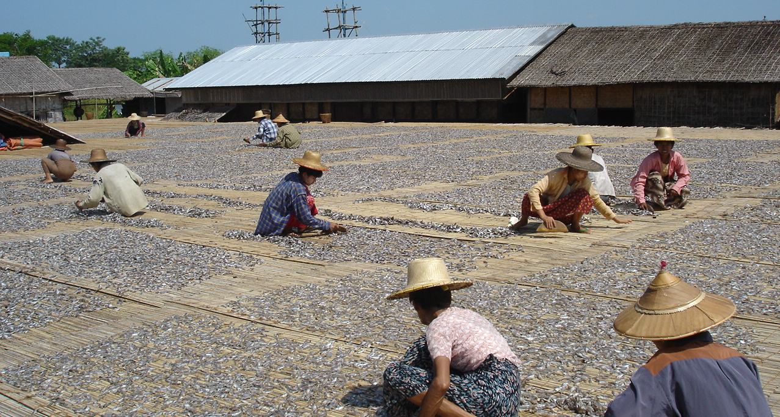
Ayeyarwaddy delta, Myanmar Case study

Slide 2
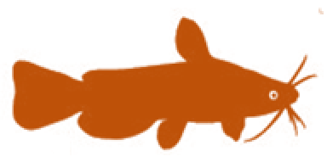
Session objectives
2
1. Good governance
2. Appropriate scale
After this session you will be able to:
Recognize how Myanmar has adopted EAFm principles and moved towards EAFm (case study)
Determine where your country is at in moving towards EAFm
Identify challenges your country faces in moving towards EAFm
3. Increased participation
4. Multiple objectives
5. Cooperation & coordination
6. Adaptive management
7. Precautionary approach
2
Notes:
The session has 3 objectives;
The USA experience used here for 1st objective and to guide the 2nd and 3rd objectives.
Objectives 2&3 are addressed through activities

Slide 3
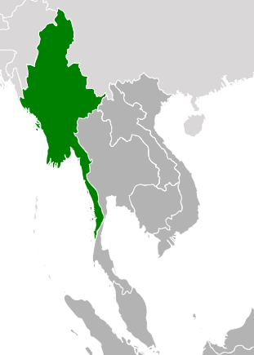
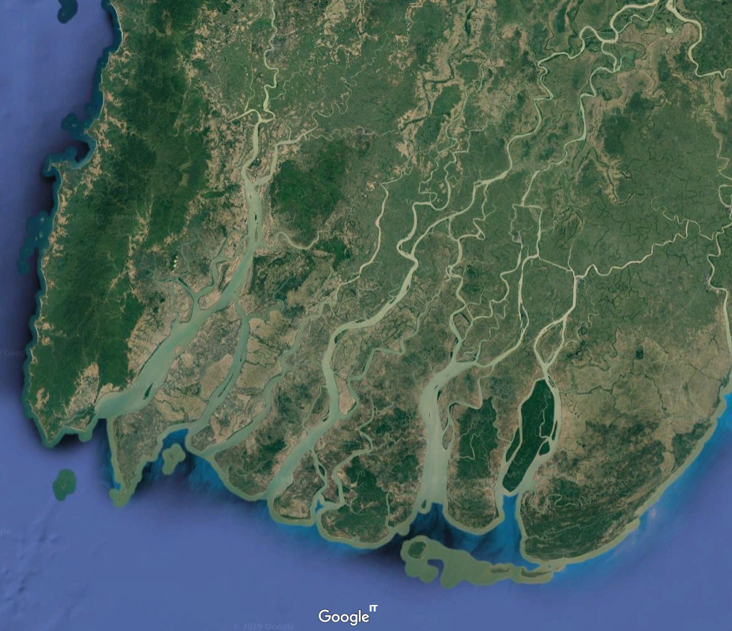
Strengthening pro-poor fisheries Governance, Ayeyarwaddy Region, Myanmar
The session will discuss how
Myanmar’s freshwater fisheries laws and policies have been influenced by the EAFm
The 7 EAFm principles are being adopted into freshwater fisheries management

Slide 4
Ecology: the delta ecosystem
Ayeyarwaddy Delta
Extensive river / canal network
Fish Biodiversity– high
>388 fish species in the Basin
193 (50%) endemic to the Basin,
100 (26%) of the endemics are only found in Myanmar.
Ecology influenced by seasonal salt water intrusion and retreat.
Floodplain zone
March salinity front
Estuarine zone
Coastal front
November salinity front

Slide 5
Ecology: pressures on the system
Pressures:
Intensification of rice farming practices, through inorganic fertilisers, herbicides and pesticides
Use of dry season water bodies for irrigation or recession planting
Lost floodplain connectivity through roads and embankments, (including aquaculture pond embankments
Natural resource degradation and decline in fisheries production
Have triggered demands from small-scale fishers for sustainable resources co-management

Slide 6
Fisheries
Large and migratory species of commercial significance,
Catfishes (Wallago attu and Pangasius species),
Hilsa, Tenualosa ilisha – anadromous- one of the Ayeyarwaddy’s most economically important fish species.
Catla catla, Cirrhinus cirrhosus, Labeo calbasu, Lates calcarifer, Pangasius pangasius, Rita sp., Silonia silondia. Chana striata, and Clarias sp
Declining catches have triggered demands from small-scale fishers for sustainable resources co-management.

Slide 7
Livelihood and economic contribution
Delta fisheries exploited by large and small-scale fishers and farmers.
Many fishers are full-time and landless
Poverty rife in fishing communities
Important generator of food, employment and wealth
Domestic, regional & export markets
Processing of fish source of income for rural households
Women play important roles
Increasing calls from fishers for
more equitable sharing of access to natural resources
sustainable resources co-management

Slide 8
Governance: fishery reforms
Historically, fisheries governance focused on revenue generation
Gradual reduction in small-scale fisher access to traditional fishing grounds
Since 2012, freshwater fishery governance has steadily improved
New laws and pro-poor policies introduced in several states and regions
Following successful pilots, fisheries co-management being rolled-out
Small-scale fisher access to fishing grounds is improving
The integration of EAFm into this transitional process could
strengthen community fisheries co-management capacity
provide way for fisheries officers to engage effectively with community fisher organizations

Slide 9
Timeline: 1905 - 2018
Auction system for tenure rights
Commons fishing grounds 75%
Privatization of FW fishing grounds
Decentralization of fishery regulation
Small-scale fishers demanding their rights for fishing
1905
1970
1988
1991
2010
2012
2018
1991 Freshwater fishery act
2012 Ayerawaddy Freshwater fishery Law
Regional fishery laws for co-management and SSF Rights
Quasi-socialist government
Military Government
Elections
Source: NAG (2011) Tender process analysis

Slide 10
Moving towards EAFm – 7 principles
EAFm principle | How it is being implemented
Good Governance: | Changes in policies and laws attempt to redress gross stakeholder inequalities, and chronic resource degradation
Appropriate Scale | Myanmar’s decentralization of inland fisheries governance allows fine tuning of legislation and policies to local conditions and contexts.
Increased participation | At the heart of the governance reforms has been the organization of community and stakeholder groups with an interest in improving fisheries governance, and facilitating their active involvement in policy and law developments.
Multiple objectives | The approach aimed to meet the following objectives Pro-poor fisheries governance mainstreamed by Government Improved livelihoods and incomes for small-scale fishers Stronger community organisations and community leaders Sustainable natural resources management Increased transparency, reduced corruption in revenue from fisheries

Slide 11
Moving towards EAFm – 7 principles (2)
EAFm principle | How it is being implemented
Cooperation and coordination | Creation of community associations and networks allowed for consistency in approach and the coordination of lobbying efforts. This was essential given the isolation of the many remote and disparate fishing communities in the Delta.
Adaptive Management | Process to develop a legal framework providing more equitable and sustainable benefits a process of trial and error lasting >10 years. Lessons from other countries, (e.g. Cambodia, Thailand) crucial in showing alternative governance systems in operation, and facilitated the flexible approach adopted by law and policy makers.
Precautionary principle | Reforms proposed and subsequently agreed, did not attempt to displace the existing leasehold and tender systems. Sought to increase stakeholder benefits in lower value fisheries. Preceded by extensive piloting by CSOs to demonstrate how community co-management approaches could benefit poorer fishing households and improve local natural resources management.

Slide 12
Strengthen the capacity to deliver
NGOs and CSOs leading the capacity building of community fisheries organizations
Conservation in resource management plans generally weak.
The integration of EAFm could improve the extension capability and impact of the DoF,
Provide tools for fisheries officers to engage effectively with community fisher organizations
Strengthen community co-management capacity leading to more sustainable fisheries and their equitable use

Slide 13
Key messages of case study
EAFM is a step by step process; apply lessons learned along the way
increasing stakeholder engagement
broadening scale and scope of management
built on existing fisheries management
strengthen governance
Many fisheries in the world are doing EAFM in part;
Each country is a different stage of the journey
13
Notes:
Self explanatory

Slide 14
Activity 1:
Each group receives a card that displays one EAFM principle (some groups may have to consider two principles).
In groups, discuss and score where you think your COUNTRY is along the continuum 0-5 for that principle.
Using the lines set out on the floor, one representative for each principle paces out their score while holding the card.
Notes:
1. For 10 minutes, participants work as a group to establish their score for their allotted principle.
2. Using the lines set out on the floor, one representative for each principle paces out their score while holding the card.

Slide 15
Activity 2: In groups
Identify the challenges your country might face in moving towards EAFM
Write each challenge on a card. (ONE challenge per card)
Now identify opportunities your country may have in moving towards EAFM (and in meeting the above challenges).
Write each opportunity on a separate card
Notes:
1. Participants share initial ideas with neighbour (in pairs)
2. As a group, identify and write 2-3 constraints (challenges) THEIR COUNTRY might face in trying to move towards EAFM (refer to output from activity 1). Write only 1 challenge per card, on e.g. green cards.
3. Get same groups to identify opportunities (write these on different colour cards, e.g. yellow). A challenge in one country may be an existing opportunity in another.
4. Get all groups to walk to back of the room and place constraints and opportunity cards on the floor (on 2 differently-labelled flipcharts).
5. Trainer groups cards (on floor, with all participants helping) and facilitates a brief discussion. Match opportunity cards to challenges cards if possible. Have brief discussion about overcoming challenges- elicit ideas from participants (linking to local/country continuum table produced earlier on flipchart, as well as threats and issues from day 1).
Trainer sorts and keeps outputs for days 3 and 4 (see session plan).
Possible challenges for countries moving to EAFM: lack of funding; lack of government structures; lack of government support; corruption; short term government posts (i.e. reflect short term perspective only); misconception about management structures needed; decentralisation means responsibility is passed on; weakness of fisher associations/ groups; hierarchical social structure (i.e. does not favour stakeholder participation)…

