Slide 1
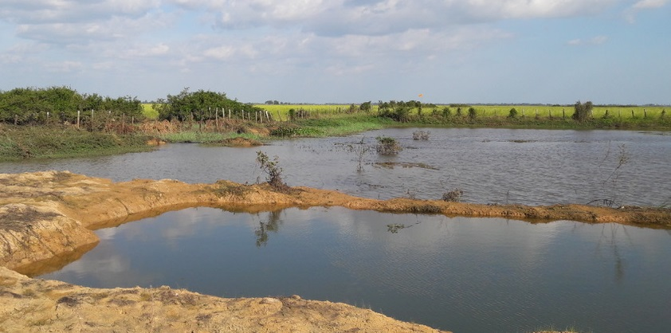
Strengthening Community Fish Refuge & Ricefield Fisheries, Cambodia Case study

Slide 2







Session objectives
2
1. Good governance
2. Appropriate scale
After this session you will be able to:
Recognize how Cambodia has adopted EAFm principles and moved towards EAFm (case study)
Determine where your country is at in moving towards EAFm
Identify challenges your country faces in moving towards EAFm
3. Increased participation
4. Multiple objectives
5. Cooperation & coordination
6. Adaptive management
7. Precautionary approach
2
Notes:
The session has 3 objectives;
The USA experience used here for 1st objective and to guide the 2nd and 3rd objectives.
Objectives 2&3 are addressed through activities

Slide 3
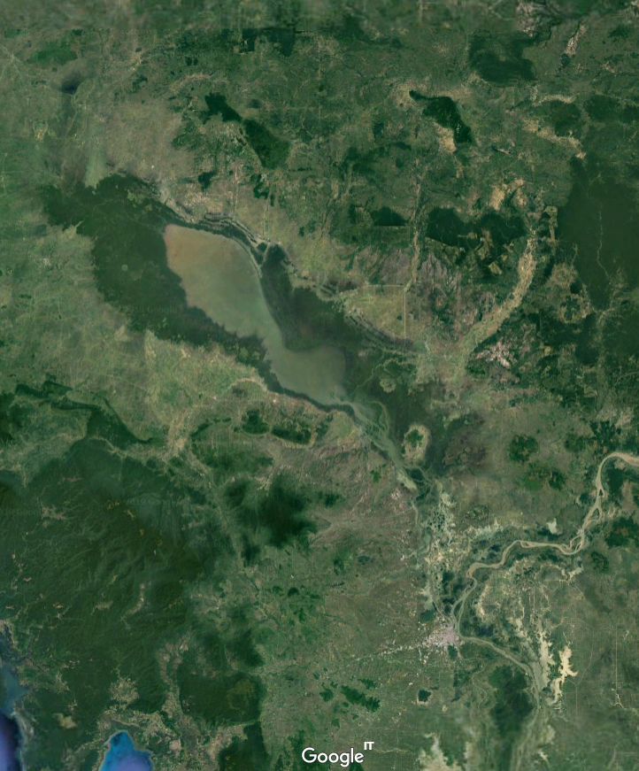
Cambodia: Strengthening Community Fish Refuge & Ricefield Fisheries Co-management
The session will discuss
The emergence of community fisheries refuge (CFR) and ricefield fisheries co-management in Cambodia as an example of EAFm.
How Government policies have changed to incorporate RFF
The important roles that INGOs have played.
Opportunities for strengthening RFF and CFR co-management using EAF principles.

Slide 4
Ecology: Cambodian ricefield fishery system
During the monsoon season, rain-fed and deep-water rice-ecosystems cover about 1.8 million hectares in Cambodia
In Cambodia, many rural farming families are engaged in small-scale fishing in and around rice fields.
A practice that is probably as old as rice farming itself.
For many decades the science of ricefield fisheries ‘fell between two stools’- capture fisheries & aquaculture,

Slide 5
Ecology: Cambodian ricefield fishery system (cont.)
The movement of wild fish between flooded areas is thought to play an important part in the overall productivity of the ricefield fisheries.
Productive CFR/RFF systems should contain
  Dry season refuge areas,
  Channels for out-migration and back-migrations of fish
  Rice fields and adjacent water areas.

Slide 6
Ecology: How ricefield fishery refuges work
DRY SEASON REFUGE
Fishing in refuge
Early wet season
Out-migration of broodstock and juveniles
Traps in migration paths
Back-migration
End of wet season
Migration mortalities
Traps in migration paths
Trap ponds
RICEFIELDS
Large increase in biomass of fish and other aquatic animals
Fishing and foraging in ricefields and surrounding water bodies

Slide 7
Fisheries: in ricefield systems

Slide 8
Fisheries
Predominantly air breathing (black) fish such as snakehead and clarias catfish
Some smaller fish e.g. Rasbora sp., Trichogaster sp.
Other aquatic animals form important parts of the ‘fishery
e.g. crabs, shrimps, frogs, molluscs and aquatic insects,

Slide 9
Fisheries timeline
Royal Decree on Guidelines on Cambodia’s community fisheries
First study of ricefield fisheries (RFF)
AIT Outreach/DOF studies highlight importance of RFF
RFF recognized in national fisheries statistics
1980
1990
2000
First community fish refuge pilots (CFR) – Svey Rieng
>0.5m hectares private fishing lots transferred to public
2020
2010
CFR becomes national level strategy
Community fisheries Office established in FiA

Slide 10
Ecology: Threats
A number of sources;
  increases in fishing pressure;
  agriculture intensification;
  modified ecosystems,
  loss of flooded forest and bush habitats;
  irrigation/road infrastructure development, creating obstructions to fish movement.

Slide 11
Livelihoods and socio-economics
Until 1990’s importance of ricefield fisheries to rice farming communities largely ignored
  by governments, researchers and rural development
Produce by-passes conventional value chains and markets
  = underestimation of value and importance.
Studies in Cambodia from 1994 highlighted the importance of aquatic ricefield animals
  for nutrition
  incomes, (particularly from trap ponds catches)
Generally, poorer households involved in ricefield fisheries, including landless households.
Women and children play major roles in fishing and processing.

Slide 12
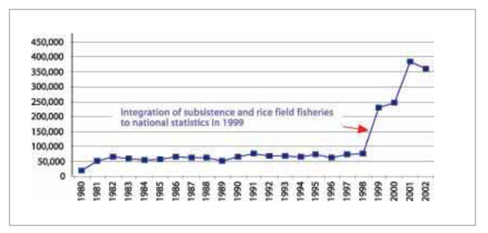
Governance: Fisheries
Recognition of RFF contribution estimated for Cambodia fisheries statistics from 1999
Trap pond excavation remains banned within Great Lake floodplain, between national highways 5 & 6
Policy target: 1 200 communes (75% of national total) to have sustainable community fish refuges by the end of 2019

Slide 13
Moving towards EAFm – 7 principles
EAFm principle | How it is being implemented
Good Governance: | Decentralised governance to community level. Benefits from fisheries spread more broadly
Appropriate Scale | Zone of influence used to scale community fisheries refuge plans. Where ZOI overlap, then appropriate scale can increase.
Increased participation | Communities establish committees for CFR management Involvement of communities in developing ricefield fisheries/refuge plans and monitoring impact of management measures.
Multiple objectives | Most CFR are multi-purpose resources CFR plans include other community demands such as irrigation, livestock watering, drinking water supply.

Slide 14
Moving towards EAFm – 7 principles (2)
EAFm principle | How it is being implemented
Cooperation and coordination | Communities CFR ZOI may overlap, creating opportunities for management cooperation .
Adaptive Management | Communities adjust CFR plans based on the prevailing monsoon conditions and on their experience during previous years. Annual meetings held to agree/adjust management plans. Sharing of experiences between communities, encouraged
Precautionary principle | No stocking of exotic fish species. Strict limitations on adult fish taken from the CFR.

Slide 15
Strengthen the capacity to deliver.
There are significant capacity issues, at all levels to address.
Scientific understanding of how ricefield fisheries systems operate
  in different locations
  in differing flooding inundation years
Capacity of extension workers to be able to work comfortably with both the ecological and social complexity of RFF
Capacity to effectively measure impact of RFF co-management interventions
Capacity of communities to organize themselves effectively;
  to develop meaningful CFR plans;
  Ensure co-management compliance within the community;
  and monitor their effectiveness

Slide 16
Key messages of case study
EAFM is a step by step process; apply lessons learned along the way
  increasing stakeholder engagement
  broadening scale and scope of management
  built on existing fisheries management
  strengthen governance
Many fisheries in the world are doing EAFM in part;
Each country is a different stage of the journey
16
Notes:
Self explanatory

Slide 17
Activity 1:
Each group receives a card that displays one EAFM principle (some groups may have to consider two principles).
In groups, discuss and score where you think your COUNTRY is along the continuum 0-5 for that principle.
Using the lines set out on the floor, one representative for each principle paces out their score while holding the card.
Notes:
1. For 10 minutes, participants work as a group to establish their score for their allotted principle.
2. Using the lines set out on the floor, one representative for each principle paces out their score while holding the card.

Slide 18
Activity 2: In groups
Identify the challenges your country might face in moving towards EAFM
Write each challenge on a card. (ONE challenge per card)
Now identify opportunities your country may have in moving towards EAFM (and in meeting the above challenges).
Write each opportunity on a separate card
Notes:
1. Participants share initial ideas with neighbour (in pairs)
2. As a group, identify and write 2-3 constraints (challenges) THEIR COUNTRY might face in trying to move towards EAFM (refer to output from activity 1). Write only 1 challenge per card, on e.g. green cards.
3. Get same groups to identify opportunities (write these on different colour cards, e.g. yellow). A challenge in one country may be an existing opportunity in another.
4. Get all groups to walk to back of the room and place constraints and opportunity cards on the floor (on 2 differently-labelled flipcharts).
5. Trainer groups cards (on floor, with all participants helping) and facilitates a brief discussion. Match opportunity cards to challenges cards if possible. Have brief discussion about overcoming challenges- elicit ideas from participants (linking to local/country continuum table produced earlier on flipchart, as well as threats and issues from day 1).
Trainer sorts and keeps outputs for days 3 and 4 (see session plan).
Possible challenges for countries moving to EAFM: lack of funding; lack of government structures; lack of government support; corruption; short term government posts (i.e. reflect short term perspective only); misconception about management structures needed; decentralisation means responsibility is passed on; weakness of fisher associations/ groups; hierarchical social structure (i.e. does not favour stakeholder participation)…

