Slide 1
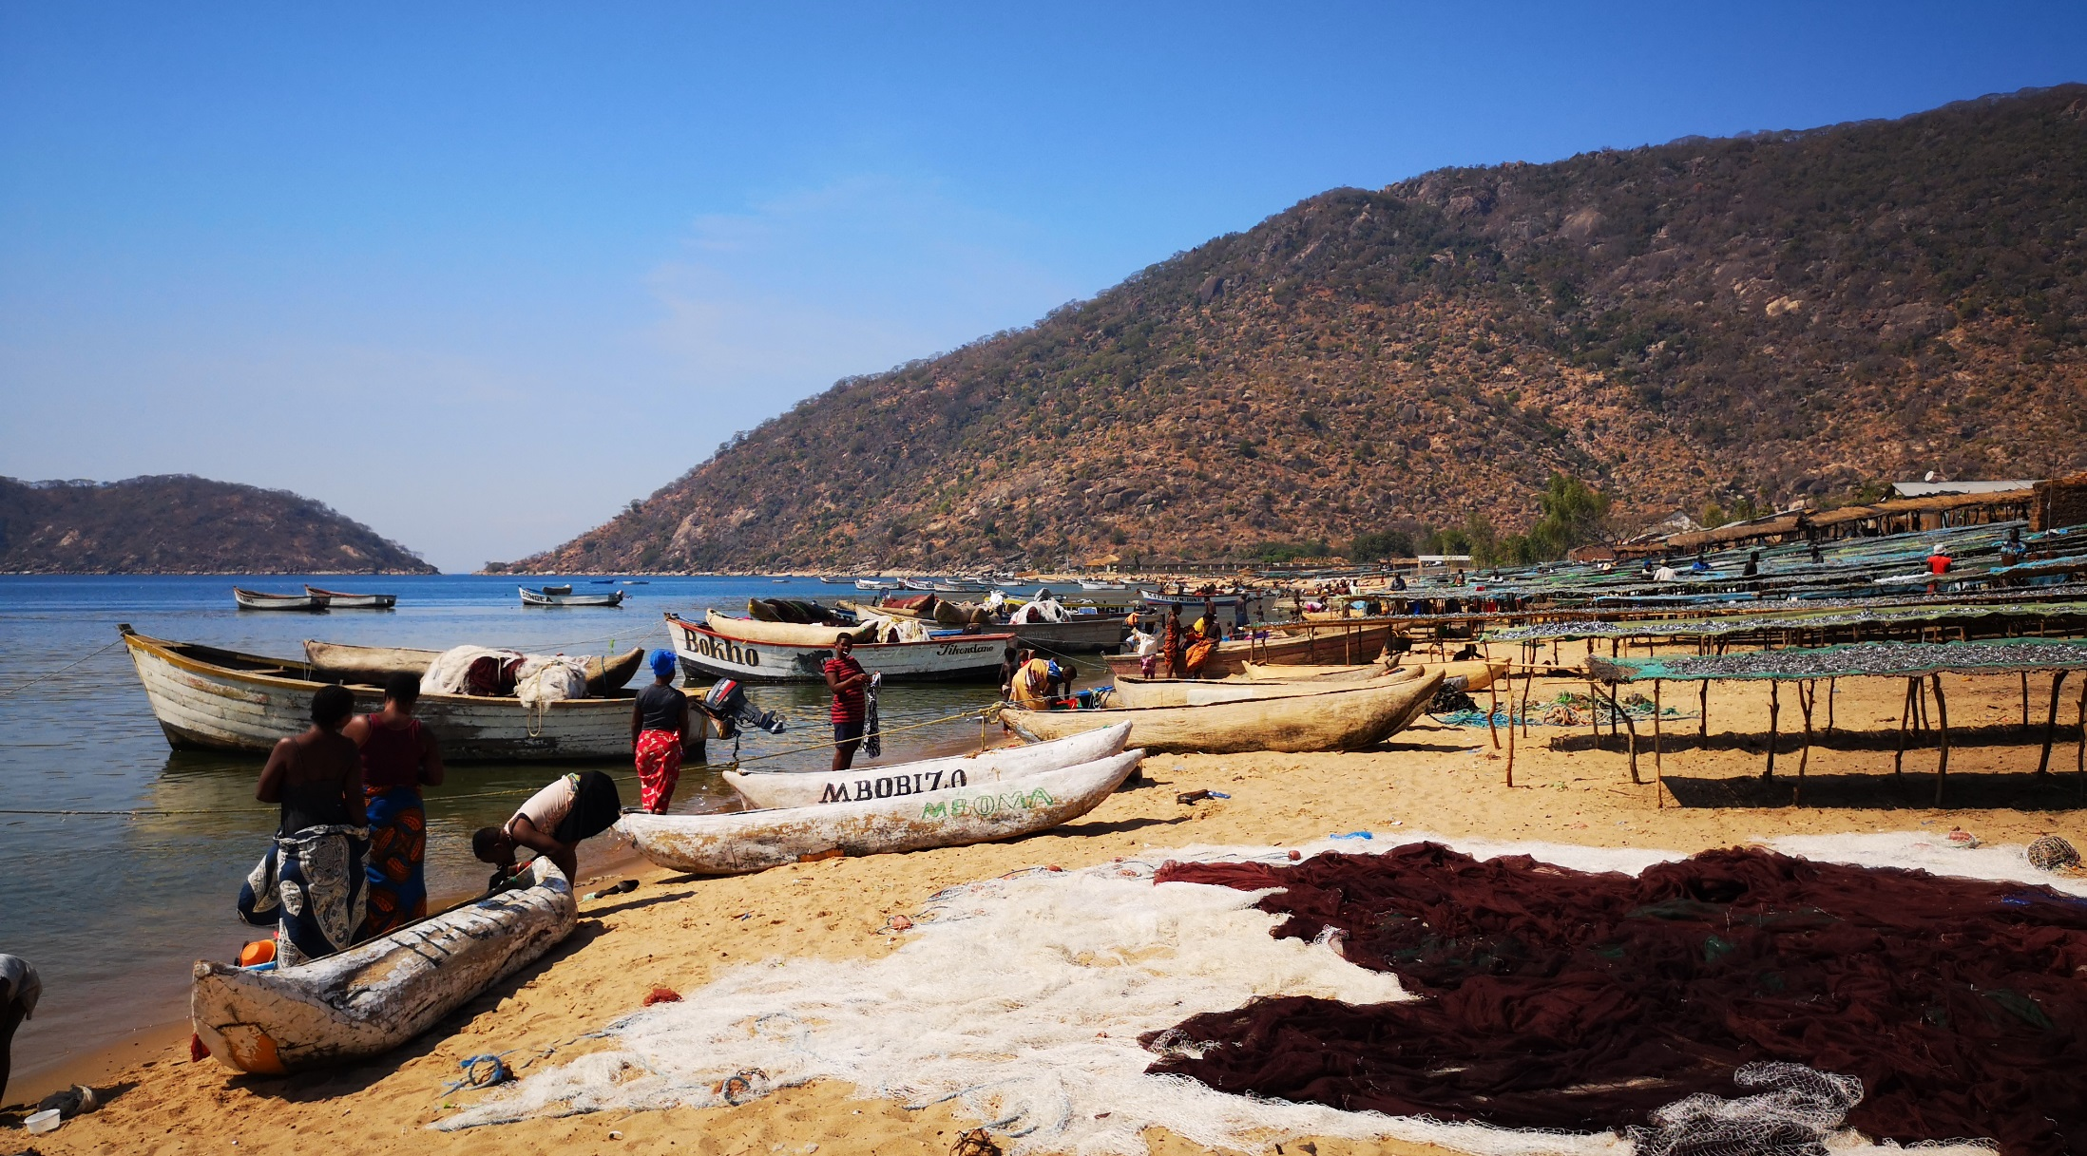
Lake Malawi-Malombe Case Study

Slide 2



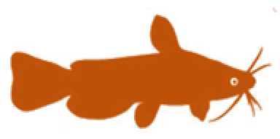



Session objectives
2
1. Good governance
2. Appropriate scale
After this session you will be able to:
Recognize how Malawi has adopted EAFm principles and moved towards EAFm (case study)
Determine where your country is at in moving towards EAFm
Identify challenges your country faces in moving towards EAFm
3. Increased participation
4. Multiple objectives
5. Cooperation & coordination
6. Adaptive management
7. Precautionary approach
2
Notes:
The session has 3 objectives;
The Malawi experience used here for 1st objective and to guide the 2nd and 3rd objectives.
Objectives 2&3 are addressed through activities

Slide 3
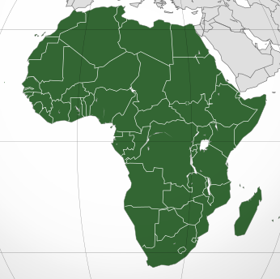
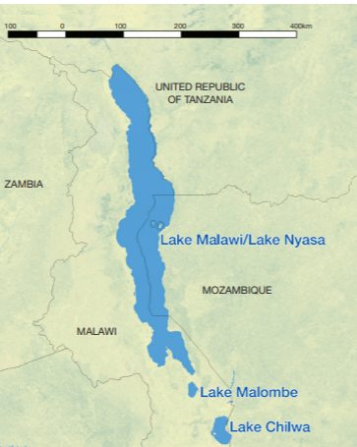
Overview: Lake Malawi-Malombe case study
FAO
  For several decades, Malawi has been moving towards increasing community participation in fisheries co-management
    The session will discuss how:
  fisheries management, laws and policies have moved toward EAFm
  seven EAFm principles are becoming adopted into fisheries management
Source: Kolding et al.(2019).Freshwater small pelagic fish and fisheries in major African lakes and reservoirs in relation to food security and nutrition

Slide 4
Introduction
This presentation describes EAFm trends for three parts of the southern Lake Malawi system
  SE and SW arms of the main Lake
  Lake Malombe, which lies to the south
  the connecting channel, known as the Upper Shire

Slide 5
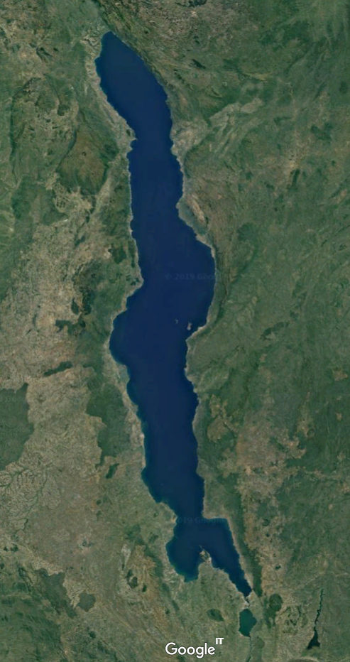
Ecology: Lake Malawi
Lake Malawi, known as Lake Nyasa (Tanzania), Lago Niassa (Mozambique)
  Southernmost of the African Great Lakes in Rift Valley
  Surface area 29 600 km²
  4th largest fresh water lake (volume), 9th largest (area)
706m deep at its deepest point.
  Far south of the lake is shallower < 200m deep
Evaporation = 80% of the water loss from the lake
  considerably more than Shire River outflow at southern end
Water layers stratified and do not mix

Slide 6
Ecology: Lake Malawi (cont.)
SE and SW arms diverse ecosystems : rocky areas, submerged and emergent aquatic vegetation, small islands, and flooded zones
Important breeding areas/habitats
  Submerged and emergent vegetation
  Tributaries flowing into the SE arm and lake - Cyprinid and clarias catfish species migrate upstream to spawn in rainy season
  Shallow water, shoreline: Usipa reported to breed in waters 1-2m deep, along shore of the SW (Morioka & Kaunda 2005)
Threats
unprecedented extreme weather events
prolonged heavy wind action
reduced water levels
extreme low and high temperatures and unpredictable rainfall patterns

Slide 7
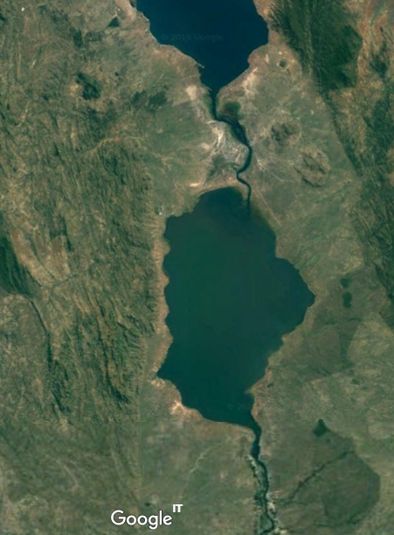
Ecology: Lake Malombe
The third largest water body in Malawi after Lakes Malawi and Chilwa.
  Surface area = 390km² (30km x 15 km )
  Average depth = 5m.
  Catchment 3 387km²
Bottom substrate is muddy, water is usually turbid
  Deepest sections follow the path of the original Shire riverbed
  Shallowest areas are located along the western and south-eastern shoreline

Slide 8
Ecology: Lake Malombe (cont.)
Important breeding areas/habitats
  Vegetation within Lake Malombe and Upper Shire important formany species including Oreochromis karongae
  River inlets/outlets and shallower sections of the lake important nursery habitat
  Many Lake Malombe fish use remaining emergent and submerged aquatic vegetation areas, and river inlets and outlets during their juvenile and adult stages
Threats
In recent years dense beds of submerged and emergent aquatic vegetation reduced.
Affected Chambo stocks by reducing the available breeding habitat

Slide 9
Fisheries: Artisanal Fisheries of Lake Malawi
Artisanal fisheries contribute 85 – 90 % of total fish landings
Multi species/multi gear fishery
Annual fish catch in Southern Lake Malawi
  1970-1980 Chambo dominated catches (declined in the early 1990’s)
  Catch 22 000 metric tonnes (2007 – 2011)
  Declined to 18 000 tonnes (2012 – 2015)
  3 fish groups now dominate catches (Haplochromines, Usipa and Mlamba)
Fisheries under pressure:
  open access
  increasing local population
  few options for alternative livelihoods outside of fishing.
  environmental degradation.
  boom in the construction of resorts

Slide 10
Fisheries: Commercial Fisheries of Lake Malawi
Trawling and purse seining (‘ring nets’) in southern part of Lake Malawi.
  By 2016, 32 pair-trawlers & 8 stern-trawlers (catches dominated by haplochromine cichlids)
Decline in annual landings from >3 000 tonnes (mid-1980s) to <1 000 tonnes (present)
  increased commercial fishing effort & use of large HP vessels
  encroachment of trawlers into artisanal fishing grounds and during closed seasons
  undersized cod end mesh
  increased number of unlicensed fishing gear operators
Situation exacerbated by
  high post-harvest losses due to poor handling and processing
  environmental degradation & climate change impacts
  transitioning of the fishery from multi-species to a fishery dominated by a single species- Usipa
  2 ornamental fishing operations (Mbuna, highly coloured cichlids).

Slide 11
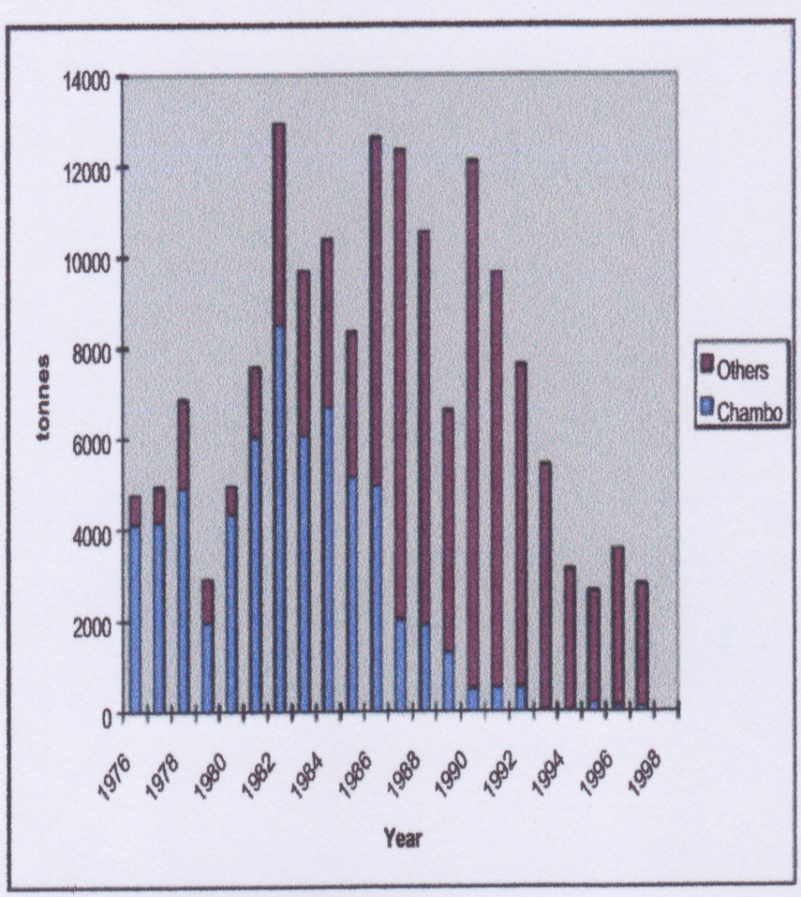
Fisheries: Artisanal Fisheries of Lake Malombe
Only artisanal fishing - no trawlers
Current fish production from Lake Malombe estimated at around 4 500 metric tonnes/year .
Fisheries of high local importance.
Catches declining
Multi-species and multi-gear fishery.
Dominant species Haplochromines (Kambuzi and Mbaba)
90% of the total landings Chambo catches declined significantly during the period 1975-1998. Now <1% to the total catch..
Other landed fish species include Mlamba, Usipa and Sanjika.

Slide 12
Livelihoods and socio-economics: Employment
Lake Malawi
SE and SW arms provide full-time fisher livelihoods for around 16 000 people.
40 000 other people involved in support activities such as fish trading, boat building fish gear construction.
Lake Malombe/ Upper Shire
Number of fishers 755 (2010) – 5 398 (2016)

Slide 13
Livelihoods and socio-economics: Issues
Conflicts
  Lake Malawi: Conflict between trawler operators and artisanal fishers
  Lake Malombe/ Upper Shire: Nkacha fishers active throughout the year;
  Closed season violations common, fuelling conflict
  Theft of fishing gears; destruction of fishing gears by nkacha (seines)
Health: HIV/AIDS Infection rates in fishing communities are higher than national average
Gender: Fishing on Lake Malawi is dominated by males, but women engaged through ownership of fishing gears as well as engagement in fish trading and processing
Child Labour: school age children frequently engaged in fishing, fish processing and marketing
Livelihood viability now threatened by climate change

Slide 14
Timeline: 1980 - 2000
Lake Malawi
1994 Loss of political will
1
Introduction of pair trawl
High lake levels
1993 DOF get Research Vessel
Fishery Conservation & Management act
2
Decline of Chambo
Chambo Plan
1988-90
Introduction of co-management
1980
1985
1990
Dawn of Democracy
1995
2000
Invention of Nkacha net
1986 Abundant Usipa
L. Malombe recession
Kambuzi decline & fish kills
1982 Fishers start using Nkacha net
3
Fishers change from canoes to boats
1985 Co-management in Lake Malombe
1982 Increasing catch of Chambo
Lake Malombe

Slide 15
Timeline: 2000 - 2018
Lake Malawi
Boom of (illegal) monfilament gillnets
Usipa management strategy
Rise of Usipa catches
Mapping of biodiversity hotspots
Boom of mosquito nets
LED light fishing
Fish mortality
Closure of Blantyre netting co.
Food crisis
Boom of alternative fishing gear
DOF moved to MoAIWD
De-centralization
2000
2005
2010
2015
Natl. Fishery & Aquaculture Policy
2020
Natl. Fishery & Aquaculture Policy
Chambo restoration plan
Fishers start using ngonogo
EAFm SE Arm & L Malombe
Fish mortality
Lake Malombe

Slide 16
Governance: promoting fishery co-management
Malawi Government objectives
  Allow fish stocks to recover to mid-1980 levels, when production was highest
  Recovery of fishery, to base mainly on sustainable harvest of high value Chambo
Fisheries co-management introduced
  Pre-1993, fisheries management approach influenced by principles of conservation
  Still applied to commercial fisheries; fixed no. of fishing units allocated to fishing zones
Post-1993, increased community participation in fisheries co-management
  Fisheries extension service strengthened through Participatory Fisheries Management approach
  Recognition of Local Fisheries Management Authorities
  e.g. Beach Village Committees (BVCs), River Village Committees (RVCs) & Fisheries Associations (FA)
  BVCs act as intermediaries between fishing communities and DoF for co-management
Introduction of sanctuary areas with the aim of improving breeding and nursery conditions for the commercially important fish species.

Slide 17
Moving towards EAFm – 7 principles
EAFm principle | Malawi/ Malombe - How it is being implemented
Good Governance: | Devolution of some fisheries management functions to local government Usipa management strategies in place in Lake Malawi
Appropriate Scale | SE and SW arms of Lake Malawi suitable scale for for EAFm Lake Malombe considered very suitable for EAFm
Increased participation | Relatively long history of local fisheries co-management institutions such as the BVCs and Fisheries Associations established and functioning.

Slide 18
Moving towards EAFm – 7 principles (cont.)
EAFm principle | Malawi/ Malombe - How it is being implemented
Multiple objectives | Conservation and livelihood management objectives Malawi Government objectives to persuade the fishing community: To allow fish stocks to recover to levels experienced in the mid-1980” and secondly To restore the recovered fishery to one based mainly on the high value Chambo, which should be harvested sustainably thereafter Recognition of importance of habitats
Cooperation and coordination | DoF has a number of partnerships with other institutions for natural resource co-management Potential for trans-national management of Lake Malawi
Adaptive Management | Management decisions supported by historical biological studies/data
Precautionary principle | Rules in place regarding introductions of exotic Nile Tilapia

Slide 19
Strengthening the capacity to deliver EAFm
Main DoF focus remains biological.
EAFm introductory course Mangochi April 2019 - well received.
EAFm has potential as a mechanism for local DoF to work with BVCs and communities
Important to win political support for EAFm
Cadre of EAFm trainers required to build capacity nationally
EAFm Training of Trainers Course.

Slide 20
Key messages of case study
EAFM is a step by step process; apply lessons learned along the way
  increasing stakeholder engagement
  broadening scale and scope of management
  built on existing fisheries management
  strengthen governance
Many fisheries in the world are doing EAFM in part;
Each country is a different stage of the journey
20
Notes:
Self explanatory

Slide 21
Activity 1:
Each group receives a card that displays one EAFM principle (some groups may have to consider two principles).
In groups, discuss and score where you think your COUNTRY is along the continuum 0-5 for that principle.
Using the lines set out on the floor, one representative for each principle paces out their score while holding the card.
Notes:
1. For 10 minutes, participants work as a group to establish their score for their allotted principle.
2. Using the lines set out on the floor, one representative for each principle paces out their score while holding the card.

Slide 22
Activity 2: In groups
Identify the challenges your country might face in moving towards EAFM
Write each challenge on a card. (ONE challenge per card)
Now identify opportunities your country may have in moving towards EAFM (and in meeting the above challenges).
Write each opportunity on a separate card
Notes:
1. Participants share initial ideas with neighbour (in pairs)
2. As a group, identify and write 2-3 constraints (challenges) THEIR COUNTRY might face in trying to move towards EAFM (refer to output from activity 1). Write only 1 challenge per card, on e.g. green cards.
3. Get same groups to identify opportunities (write these on different colour cards, e.g. yellow). A challenge in one country may be an existing opportunity in another.
4. Get all groups to walk to back of the room and place constraints and opportunity cards on the floor (on 2 differently-labelled flipcharts).
5. Trainer groups cards (on floor, with all participants helping) and facilitates a brief discussion. Match opportunity cards to challenges cards if possible. Have brief discussion about overcoming challenges- elicit ideas from participants (linking to local/country continuum table produced earlier on flipchart, as well as threats and issues from day 1).
Trainer sorts and keeps outputs for days 3 and 4 (see session plan).
Possible challenges for countries moving to EAFM: lack of funding; lack of government structures; lack of government support; corruption; short term government posts (i.e. reflect short term perspective only); misconception about management structures needed; decentralisation means responsibility is passed on; weakness of fisher associations/ groups; hierarchical social structure (i.e. does not favour stakeholder participation)…

