Slide 1
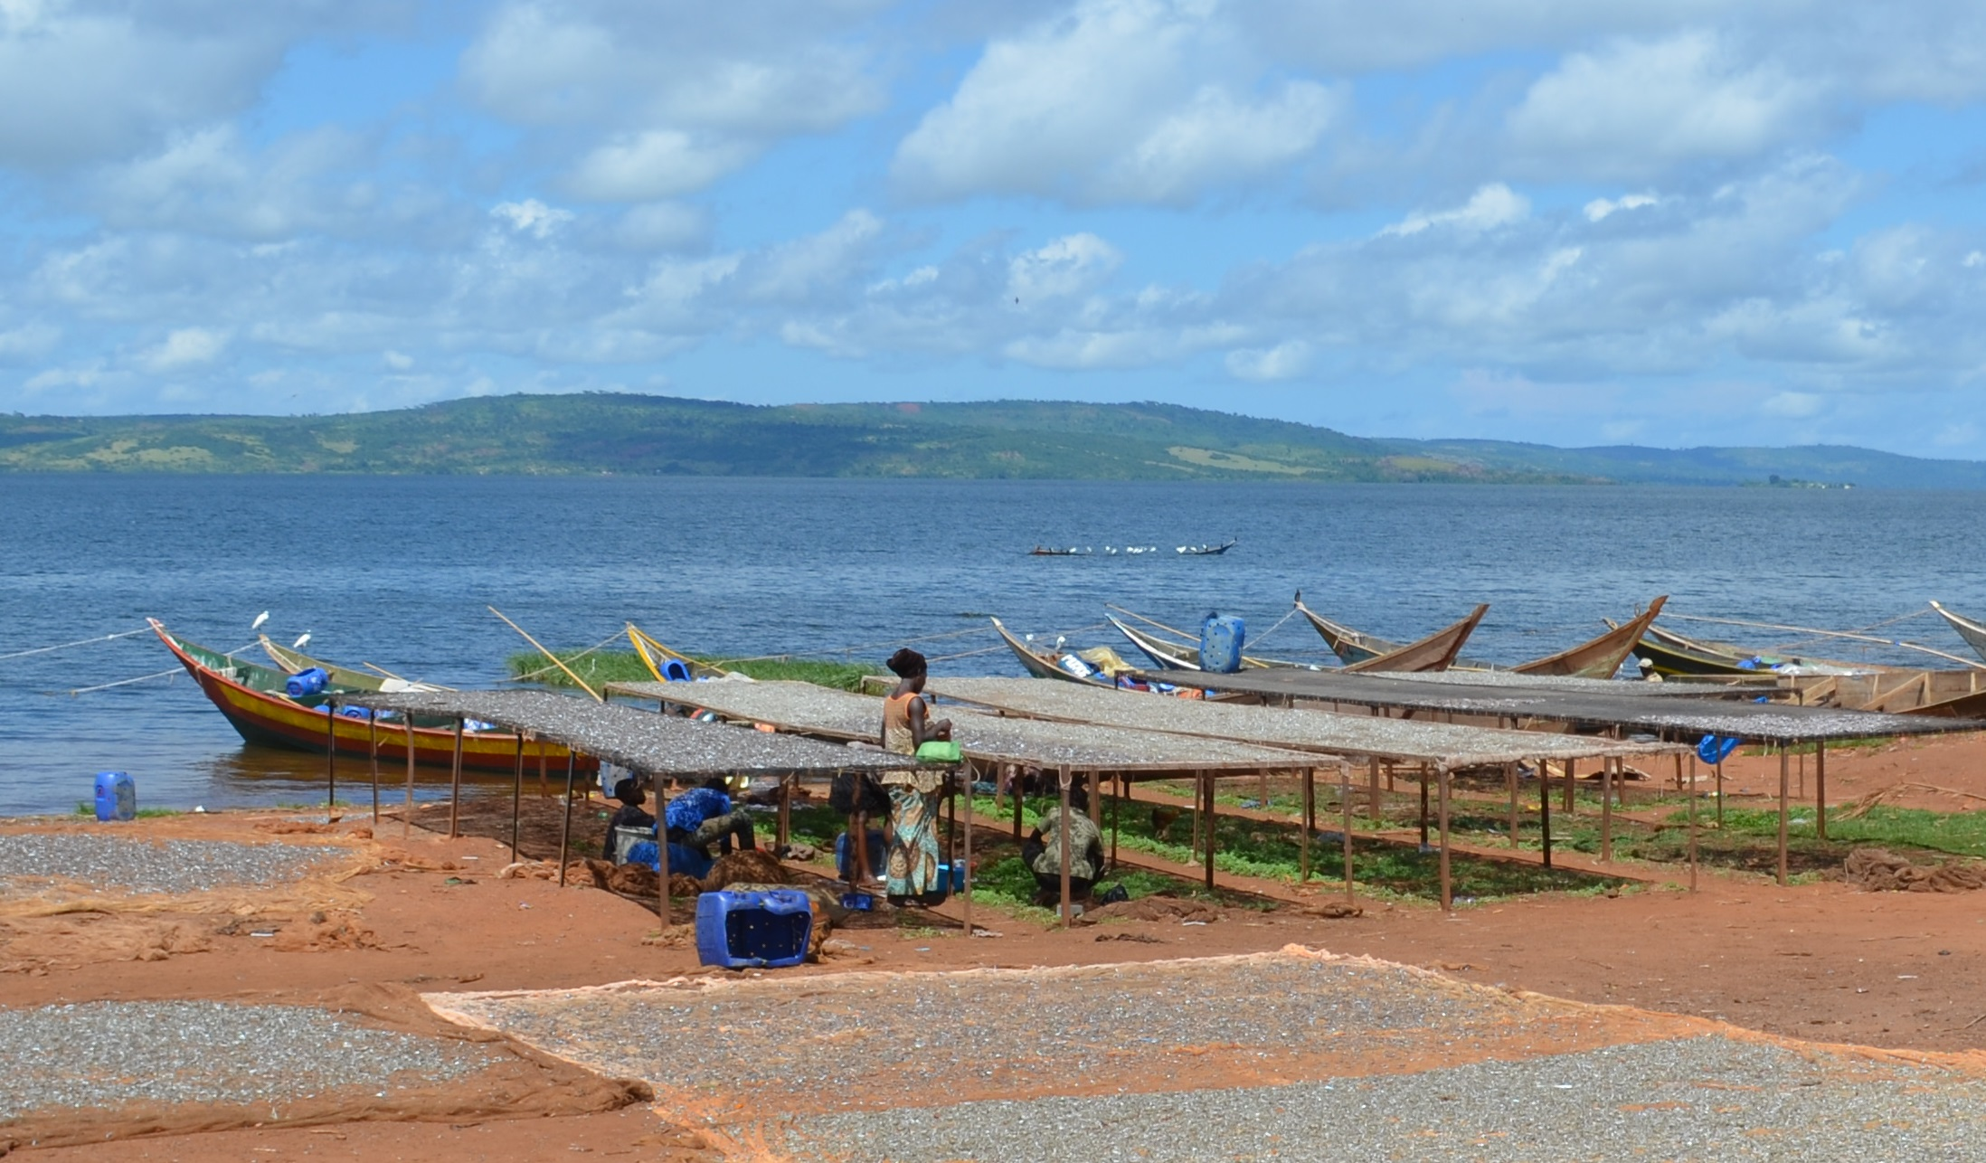
Lake Victoria Case study
Photo: Martin VanDer Knapp

Slide 2







Session objectives
2
1. Good governance
2. Appropriate scale
After this session you will be able to:
Recognize how countries around Lake Victoria adopted EAFm principles and moved towards EAFm (case study)
Determine where your country is at in moving towards EAFm
Identify challenges your country faces in moving towards EAFm
3. Increased participation
4. Multiple objectives
5. Cooperation & coordination
6. Adaptive management
7. Precautionary approach
2
Notes:
The session has 3 objectives;
The Lake Victoria experience used here for 1st objective and to guide the 2nd and 3rd objectives.
Objectives 2&3 are addressed through activities

Slide 3
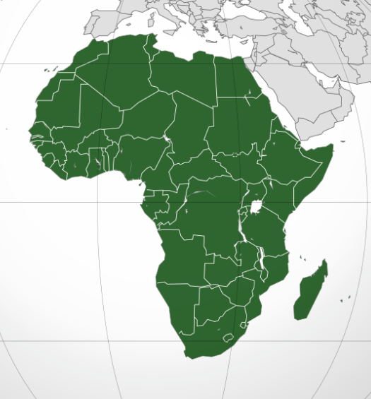
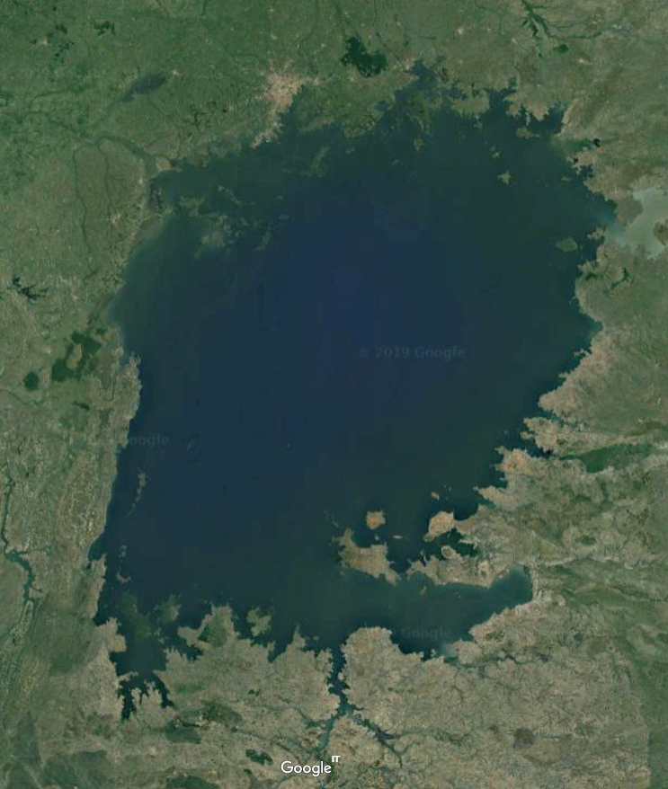
Overview – Lake Victoria case study
Uganda, Kenya and Tanzania moving from conventional fisheries management towards EAFm in Lake Victoria (since 1990)
The session will discuss how:
  fisheries management, laws and policies have moved toward EAFm
  seven EAFm principles are becoming adopted into fisheries management

Slide 4
Introduction to the Lake Victoria
Lake Surface area 68 800 km²
  Basin population >35 million
  Lake area shared
    Republic of Kenya (6%)
    United Republic of Tanzania (51%)
    Republic of Uganda (43%)
Lake is relatively shallow
  land-based nutrient runoff has effect on water quality
Largest inland water fishery in Africa

Slide 5
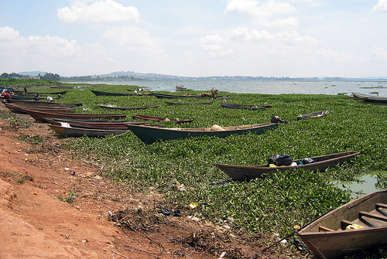
Ecology: Drivers changing Lake Victoria
Introduction of Nile Perch and Tilapia species
Rapid growth in basin population
Lake is relatively shallow, major impacts on water quality
  Land-based nutrient & sediment runoff
  Watershed degradation & deforestation
  Lost shoreline wetlands, less sediment trapping
  Industrial, urban pollution
  Reduced water inflows, lower rainfall and industrial/urban abstraction

Slide 6

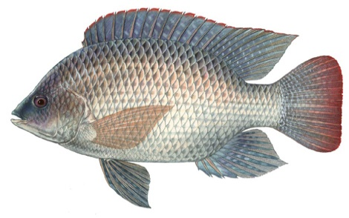
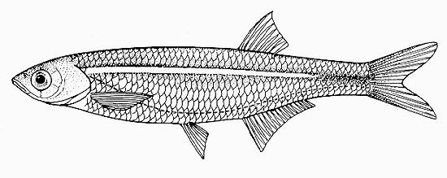
Fisheries: of Lake Victoria
Dominated by three species
  Nile perch
  Nile tilapia
  Dagaa/Mukene/Omena
> 95 % of the total fish catch

Slide 7
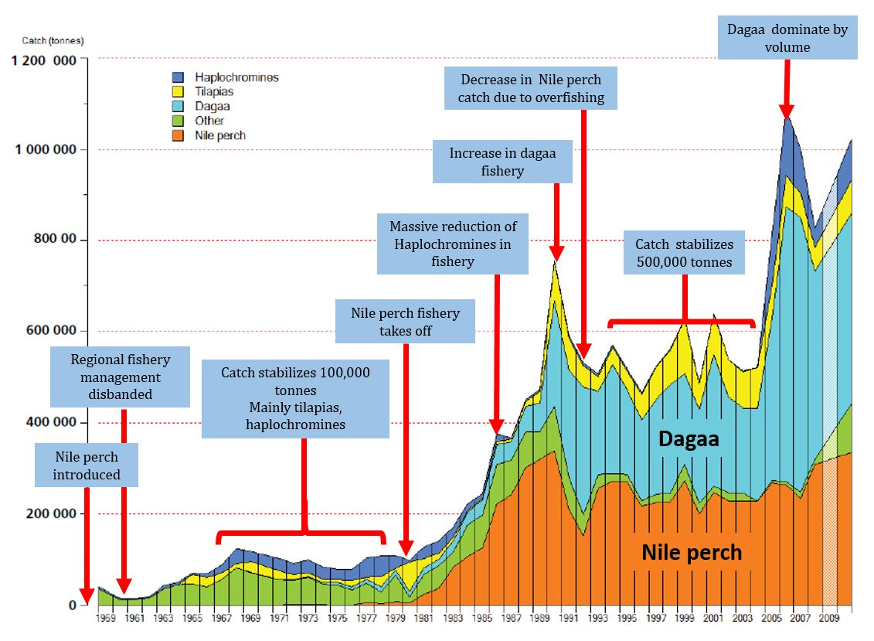
Lake Victoria fishery timeline 1950s-2013
Notes:
This slide shows a timeline of major changes in fisheries management In Lake Victoria),
This timelines demonstrates a long-term evolution toward EAF approach in Lake Victoria

Slide 8
Livelihoods and Socio-economics
Fish production relatively stable
Nile Perch international (export) & local value chains
Contributes 2-3% of national GDP (Kenya, Tanzania, Uganda)
3 million people involved in fishery, (800,000 directly)
Many small scale fishers in small-pelagic fishery
Dependent women processors and marketers
Emerging cage-based aquaculture

Slide 9
Governance: balancing income & livelihoods
Maximize commercial incomes and export earnings from the Nile Perch fishery and aquaculture?
or…
Sustain the livelihoods of hundreds of thousands of small-scale fishers & value chain participants, who are dependent on the fishery?

Slide 10
Development of regional management
1994 Lake Victoria Fishery Organization established
Co-management units start to be established
2004 Protocol for Sustainable Development the Lake Victoria Basin developed ratified
Second phase of LVEMP (2009-2017) prioritizes environmental threats in the Lake
2016 3rd fishery management plan recognizes need to balance food security and income generation

Slide 11
Moving towards EAFm – 7 principles
Good Governance
  LVFO Fishery management plan, harmonizing policies and regulations
  Regional cooperative management framework
  Rights based management >1,000 Beach Management Units (BMUs)
  BMU given legal power to manage their fisheries resources
  User-pays principle (in LVB Commission agreement)
2. Appropriate scale
  3 countries trans-boundary cooperation: goal of lake-wide management
3. Increased participation:
  Meaningful community representation in decision-making
  Active in fisheries development sector, both responsibilities and benefits
  Preferred entry point for community development intervention
  Take a role in enforcement, tenders for revenue collection, data collection, improvement in fish handling, hygiene and sanitation
  Gender and equity: Women and youth

Slide 12
Moving towards EAFm – 7 principles (2)
4. Multiple objectives
  Fisheries & Environmental protection
  LVEMP focus on aquatic habitat health & water drainage basins
  Looking for practical way to avoid environmental impacts
  LVFO monitors environment related to fisheries and aquaculture
5. Cooperation and coordination
  Links between fisheries and environment agencies?
  Cooperation between countries
6. Adaptive management
  Several iterations of FMPs, each drawing on experiences from past efforts
7. Precautionary principle…..not observed
  Risks not considered when Nile Perch introduced- Lesson learned!

Slide 13
Strengthen the capacity to deliver
Lake Victoria largest co-managed inland fishery in the world
Scientific information for management from LVFO & LVEMP
Many challenges remain
  Despite co-management, fishery management still largely top-down
  Hard to fully implement over-ambitious/over-costed plans?
  Still dependent on external funding resources
  Limited capacity to implement
Need for pragmatic planning when setting objectives

Slide 14
Key messages of case study
EAFM is a step by step process; apply lessons learned along the way
  increasing stakeholder engagement
  broadening scale and scope of management
  built on existing fisheries management
  strengthen governance
Many fisheries in the world are doing EAFM in part;
Each country is a different stage of the journey
14
Notes:
Self explanatory

Slide 15
Activity 1:
Each group receives a card that displays one EAFM principle (some groups may have to consider two principles).
In groups, discuss and score where you think your COUNTRY is along the continuum 0-5 for that principle.
Using the lines set out on the floor, one representative for each principle paces out their score while holding the card.
Notes:
1. For 10 minutes, participants work as a group to establish their score for their allotted principle.
2. Using the lines set out on the floor, one representative for each principle paces out their score while holding the card.

Slide 16
Activity 2: In groups
Identify the challenges your country might face in moving towards EAFM
Write each challenge on a card. (ONE challenge per card)
Now identify opportunities your country may have in moving towards EAFM (and in meeting the above challenges).
Write each opportunity on a separate card
Notes:
1. Participants share initial ideas with neighbour (in pairs)
2. As a group, identify and write 2-3 constraints (challenges) THEIR COUNTRY might face in trying to move towards EAFM (refer to output from activity 1). Write only 1 challenge per card, on e.g. green cards.
3. Get same groups to identify opportunities (write these on different colour cards, e.g. yellow). A challenge in one country may be an existing opportunity in another.
4. Get all groups to walk to back of the room and place constraints and opportunity cards on the floor (on 2 differently-labelled flipcharts).
5. Trainer groups cards (on floor, with all participants helping) and facilitates a brief discussion. Match opportunity cards to challenges cards if possible. Have brief discussion about overcoming challenges- elicit ideas from participants (linking to local/country continuum table produced earlier on flipchart, as well as threats and issues from day 1).
Trainer sorts and keeps outputs for days 3 and 4 (see session plan).
Possible challenges for countries moving to EAFM: lack of funding; lack of government structures; lack of government support; corruption; short term government posts (i.e. reflect short term perspective only); misconception about management structures needed; decentralisation means responsibility is passed on; weakness of fisher associations/ groups; hierarchical social structure (i.e. does not favour stakeholder participation)…

